Slide 1
Proximity, Color and Force Measurement
Kent Johnson
Spring 2011
Notes:
All right, let me begin by admitting that the more I read from these chapters, the more things I discovered that I didn’t really understand. So, please bear with me if I say things in this presentation that are patently false.

Slide 2
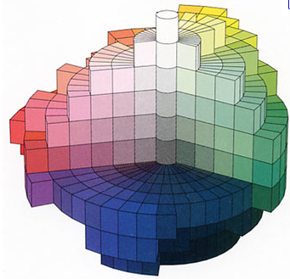
Proximity Measurements
This chapter discusses two types of models for proximity measurements:
- Geometric (spatial)
Set Theoretic (feature)
Our goal for this chapter will be
to discuss geometric models in
some detail including
multidimensional representations.

Slide 3
Chapter Overview
I. Introduction
Def 1 – Proximity Structure
Def 2 – Representable by a Metric
II. Metrics with Additive Segments
1) Collinearity
Def 3 – Collinear Betweeness
2) Constructive methods
Def 4 – Segmentally Additive Proximity Structure

Slide 4
Cont.
IV. Multidimensional Representations
1) Decomposability
Def 6 – Induced Conjoint Structure
Def 7 – One factor Independence
2) Intradimensional Subtractivity
Def 8 – Betweeness Axioms
Def 9 – Restricted solvability
Def 10 –Archimedean axiom
3) Interdimensional Additivity
Def 11 – Independence
Def 12 – Thomsen condition
Def 13 – Essential factors
4) The Additive Difference Model
Def 14 – additive difference structure
5) Additive Difference Metrics
Def 15 – Compatible with a Metric

Slide 5
Cont.
VI. Experimental Tests of Multidimensional Representations
Relative Curvature
Translation Invariance
The Triangle Inequality
VII. Feature Representations
2) The Contrast Model
Def 16 – Proximity feature structure
Def 17 – Partially Factorial
Def 18 – Factorially Comparable
Def 19 – Independence/Solvability/Archimedeanism
Def 20 – Uniform
Def 21 – Invariant
Def 22 - Extensive
2) Empirical Application
3) Comparing Representations

Slide 6
What is a proximity structure?
Proximity structures represent (duh) proximity – for example observed proximity of phenomena given stimuli with certain aspects.
The structure is often derived from data such as similarity/dissimilarity ratings or classification – ‘Each of these procedures gives rise to a proximity ordering of the form either b is closer to a than to c or the similarity of a to b exceeds that of c to d’.
Notes:
Note ax 2 can fail when the observer can’t tell the difference b/w distinct stimuli, then use equivalence classes, ax 3 can fail if observers are more likely to think that b is a, than to think that a is b.

Slide 7
How do geometric and set theoretic models differ?
Geometrical models of proximity structures attempt to define a space (for example an n-dimensional Euclidean space, or Bennett’s spring) with a metric that imbeds data points in such a way as to represent the ‘difference’ between them.
Set theoretic models represent objects or data points as sets, and compare their proximity by comparing the items in the sets.

Slide 8
Proximity Structure
There are three axioms that determine a proximity structure.
Proximity Structure (Def 1,160)
Given A and binary on A x A, for any elements
1) a is ‘closest’ to itself
1) minimality (self-similarity is always the same)
3) symmetry
If the structure is ‘factorial’, each element is composed of n components from sets A_{i,} i < n+1.
Notes:
Factorial structures will show up once we get to multidimensionality.

Slide 9
Example:
‘Colors, faces, emotions, consumer products, and political parties’
A is the set of Munsell Color Space, A₁ = hue values, A₂ = saturation values, A₃ = brightness values. And if
a₁ = {purple, very saturated, dim}
a₂ = {purple, very saturated, bright}
a₃ = {yellow, unsaturated, dim}
then (a₁,a₃) > (a₁, a₂)

Slide 10
Metrics
A proximity structure is representable by a metric if there is a metric (def 12.10, 46) on A, that preserves the ordering relation for proximity measurements. (Def 2, 162)
Any proximity structure A, with a countable order-dense subset of AxA can be represented by a metric.
If you look at the definitions it’s not hard to see why - this type of proximity structure is just begging to be represented.
Notes:
A METRIC, RECALL, is a function from a set crossed with itself onto say the reals, such that (x,x) = 0, (x,y) > 0, (x,y) = (y,x), and (x,y) + (y,z)>= (x,z)

Slide 11
An Additive Metric!
Most proximity structures of this sort are represented by additive metrics – ones where each pair of points are connected by a segment with additive distances. ie: For any point b on the segment between a and c,
δ(a, c) = δ(a,b) + δ(b,c).
Such a point can be considered ‘collinearly between’ a and c (Def 3, 164).
Solvability: Any distance, δ(e,f) shorter than δ(a,c), a point, d, can be found that lies between a and c such that (a,d) ~ (e,f).
And, if you’ve got such a solvable structure:
if <a,b,c> and <a,c,d>, then <a,b,d> and <b,c,d>.
Notes:
An exponential metric is not additive.
I don’t know why you need the solvability condition to get this Theorem.

Slide 12
Ready for Representation?!
(Def 4, 168) A proximity structure (with ordering on distance, and a betweenness relation) is segmentally additive – if
It is solvable (as described).
It is Archimedean.
And it is complete if
There is no smallest distance.
Every Cauchy sequence has a limit – ie. is infinite.
Such a structure can be represented by a segmentally additive metric (Th 3).
Notes:
A good example of a segmentally additive metric would be, say, Euclidean space
Why the no smallest distance thing? And no infinite Cauchy sequence?

Slide 13
Multidimensional Representations
So far, we have the result that certain proximity structures can be represented with additive metrics. But objects often have many features that determine their proximity (ie. for perception of humans - height, weight, hair color, ear size, etc.) – such objects have multiple dimensions of dissimilarity.
In creating a geometric (and factorial) proximity structure for a data set, one must try to determine a space with dimensionality that will properly represent proximity relations.
The goal of this section is to set up the axioms and requirements necessary to represent such a structure with a power metric, or Minkowski r-metric.
Notes:
Go back to example - factorial proximity structures

Slide 14
Power Metric!
The form of the metric is (175):
δ(a,b) = [Σ₁^{n} |ϑ(a_{i}) – ϑ(b_{i})|^{r}]^{1/r}
This form embodies four assumptions that can be considered disjointly.
Decomposability – the distance between points is a function of the distance between components (nose size, knee shape)
Intradimensional subtractivity – Each component contribution is an appropriately scaled absolute value of the difference.
Interdimensional additivity – The distance is a function of the sum of component contributions.
Homogeneity – Straight lines are additive segments
Notes:
The form of this metric can be broken down into the component parts as mentioned – certain assumptions about the proximity space in question are necessary in order to represent it with a metric that meets each one of these assumptions.

Slide 15
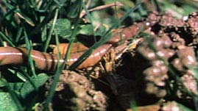
Decomposability
If the contributing components in a proximity structure are independent from each other – influence the distance values in the structure independently – and if the proximity structure (A, ) is representable, then it is decomposable (Th. 5, 179). Furthermore, such a structure will have minimality and symmetry properties for each factor.
One-factor independence is obviously important (it is necessary for decomposability). (Def 7, 178)
δ(a,b) = F[Ψ₁(a₁,b₁),…,Ψ_{n}(a_{n},b_{n})]
Notes:
And note that we have a theorem stating that for such a structure, there is a function that will represent it and preserve the distance ordering relationship.

Slide 16
Intradimensional Subtractivity
In a structure with intradimensional subtractivity, factors are decomposable, and furthermore, there is an ‘absolute difference structure’(Def 4.8) on each one. Basically, an absolute value for the difference between points of a factor can be found, and this difference can be used to create the representation.
This representation can be constructed for any proximity structures that satisfy independence, certain betweenness axioms (Def 8) and a solvability and Archimdean axiom (Def 9 and 10).
(a,b) = F[|φ₁(a₁)-φ₁(b₁)|,…,|φ_{n}(a_{n}) – φ_{n}(b_{n})|]

Slide 17
Interdimensional Additivity
Interdimensional additivity requires the perceived distances between objects to be expressible as a sum of the distances between their factors.
For interdimensional additivity, our structure must satisfy independence (which is stronger than one-factor independence, but I’m not sure why), solvability of course, and an Archimedean axiom.
δ(a,b) = G[Σψ_{i}(a_{i}, b_{i})]
Put it all together and whaddaya got?

Slide 18
Additive Difference Model/Metric
Proximity structures that meet all the conditions laid out – betweenness axioms, independence (or Thomsen condition if n = 2), solvability, and Archimedeanism are additive difference structures.
Not every such structure is compatible with a metric (def 15), but ones where can be represented by a metric, with additive segments for one-factor differences, are. Such structures that are complete and segmentally additive can be represented by the power metric.

Slide 19
Feature Representations
In this type of representation, objects are sets of features. Comparisons between two objects, a,b, are made by considering the dissimilarities between the sets (a-b) and (b-a), and the similarities (a ∧ b). These three aspects are weighted to get a representation of the form:
δ(a,b) = αφ(a-b) +βφ (b-a) – θφ(a ∧ b)
Feature representations sometimes adequately capture proximity in cases where geometric representations don’t work because of failures of subtractivity, additivity etc.
Notes:
Example of something looking more like a salient object than the salient object looks like it. Say you had the Statue of liberty, and a similar large statue of a woman, the other statue might be judged more like the statue of liberty than vice versa.

Slide 20
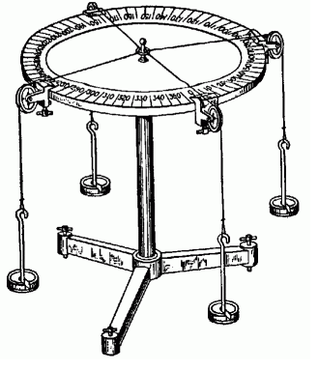
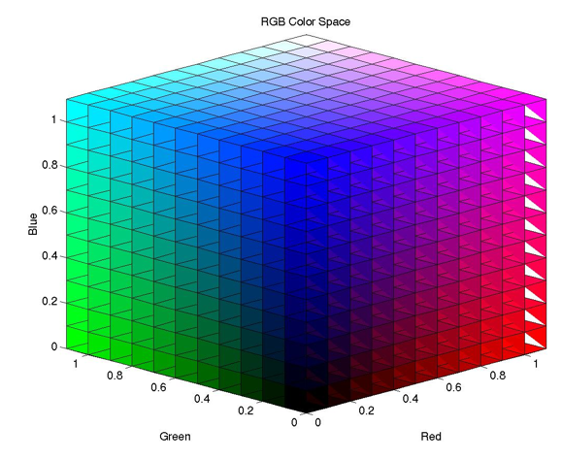
Color and Force Measurement
This chapter describes the use of Grassman structures to represent color and force measurements.

Slide 21
Chapter Overview
II. Grassmann Structures
1) Formulation of the Axioms
Def 1 – Convex Cone
Def 2 – Grassmann Structure/m-chromatic
Def 3 – Equilibrium Structure
Def 4 – Proper/Improper
IV. Color Interpretations
Metameric Color Matching
Tristimulus Colorimetry
Misunderstandings
Asymmetric Color Matching

Slide 22
Cont.
V. The dimensional structure of color and force
Color Codes and Metamer Codes
Photopigments
Force Measurments and Dynamical Theory
Color Theory in a Measurement Framework
VI. Konig and Hurvich-Jameson Color Theories
Representations of 2-Chromatic Reduction Structures
The Konig Theory
Codes Based on Color Attributes
The Cancellation Procedure
Represenation and Uniqueness
Tests and Extensions of Opponent Colors Theory

Slide 23
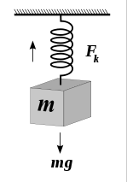
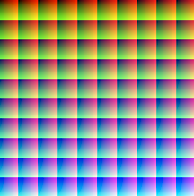
Color and Force, a match made in ?
As it turns out, there are surprising similarities between color and force measurements. These similarities are a direct result of the empirical qualities of forces and colors.
Although the empirical qualities of force and color aren’t really ‘similar’ (a force isn’t actually like a spectrum of wavelengths), they have properties that can be represented in the same ways.

Slide 24
Properties of Force and Color
So, why the surprising similarities? What are the relevant properties of force and color?
Infinite Dimensionality and Reduction –
For force, an infinite number of any-direction force magnitudes at a point can be represented by three orthogonal vectors (or one resulting vector).
For color, the eye can detect light at any wavelength between 400 and 700 nm (approximately). The physiology of the visual system (opponent processing) reduces these wavelengths to three input channels (or one resulting color sensation).
Notes:
Check if people know what a spectrum looks like.

Slide 25
Cont.
Metamerism -
For force, there are infinite configurations of force magnitudes that will have the same resultant. For color, multiple combinations of light will result in metameric color experience.
Combination and Scaling –
Forces can be combined (imagine the force table), and scaled by adding more force in each relevant direction.
Colors can be combined by simply blending lights. They can be scaled by increasing the intensity of relevant wavelengths.

Slide 26
Cont.
Three dimensionality-
Any force measurement can be represented in three dimensions (x,y, and z axis vectors), as can any color measurement (three color ‘primaries’). The first is a result of the 3-dimensionality of space, and second a result of the physiology of color vision.
‘Equilibrium’ –
Force configurations can be combined to create stasis – and any such combination mapped specially as being in ‘equilibrium’. In color matching, if each element under consideration consists of two lights, any pair where the perceptual experience is the same for both can be considered special in the same way. Color cancellation can produce an equilibrium effect as well.

Slide 27
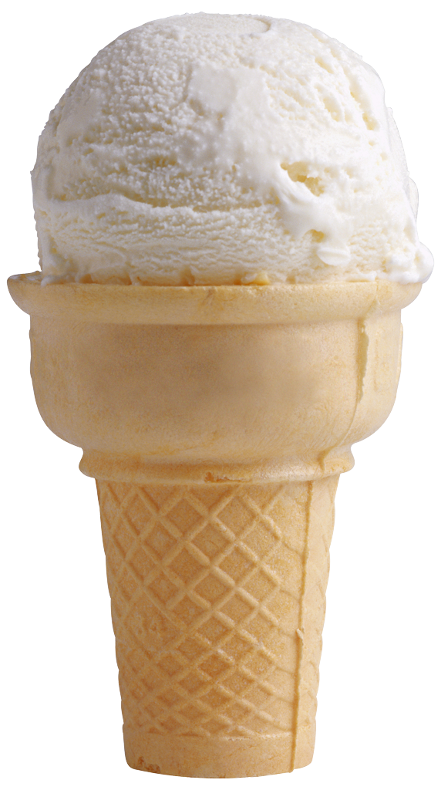
Convex Cone
Grassmann structures are a type of convex cone, so in order to understand them, we should understand this definition. (Def 1, 231)
A convex cone is a collection of objects A, a binary concatenation function from the set to itself (+), and a binary scaling function from A x Re⁺ to A (*). The following axioms must be satisfied:
Concatenation is associative, commutative, and cancels (a~b iff a+c ~ a+b).
(scalar multiplication rules)
A convex cone can be represented in a vector space – note that the binary functions map to vector addition and scaling.
Notes:
Note that convex cones are closed under concatenation and positive scaling, which is why they are called ‘cones’. When mapping them onto relevant vector spaces, a property is added to keep the vector space to only the size of the convex cone.
Draw the convex cone

Slide 28
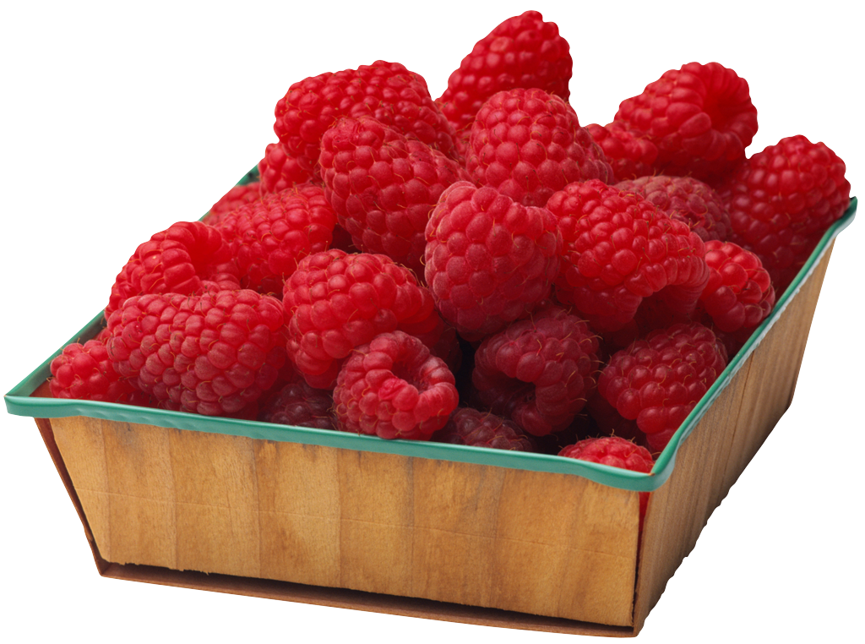
Grassmann Structures
Take a convex cone, add an equivalence relation that holds for concatenation and scaling.
Def 2 :
<A, +, *, ~> is a Grassmann structure iff <A, +, *> is a convex cone, ~ is a binary relation on A, and
~ is an equivalence relation
a~b iff a+c ~ b+c
If a~b, then t*a ~ t*b
M-chromaticity refers, in essence, to the dimensionality needed to represent a Grassmann structure.
Notes:
‘The usual statement of the Law of Trichromacy is the following i) Given any four lights, either a linear combination of three of them can be found that matches the fourth, or a linear combination of two of them matches a linear combination of the other two ii) there exist three lights such that no linear combination of any two of them matches the third.’
So, one thing I’d like to note at this point. It is clea what A is for force measurements, it’s a set of force magnitude combinations.
For color, it seems like maybe it can be two things, but I’m not very clear on this point. Either A, is a cross of lights (a,b) etc, or it is just lights.

Slide 29
Equilibrium Structures
An equilibrium structure (Def 3, 233) is a convex cone with a subset E, satifying:
Every a in A may be concatenated with a buddy to produce something in the equilibrium subset.
E is closed under concatenation.
E is closed under scaling.
A Grassmann structure is ‘improper’ if it has an associated Eq. Structure where E is {a| for all b in A, a+b ~ b}, proper otherwise. It is solvable if each member has an equilibrium buddy.
Notes:
Draw the cone again. Proper Grassmann structures won’t have a 0 element – improper ones will

Slide 30
Force Equilibrium
Note that for a force configuration to be in E, every directional component of it (think of directions as points in projected space ie. lines through the origin) must be in equilibrium. (Theorem 6, 266).
Obviously, if this is the case, then the vector representing the force magnitudes are all 0, or they perfectly oppose each other.

Slide 31
Other Aspects of Color
The basic Grassmann structure is a good representation of color measurements for the reasons listed before. However, there are other aspects of color phenomenology that we might want to include in our representations, like color cancellation, or the workings of dichromatism.

Slide 32
Viewing Conditions and Focal Distributions
The color percept that results from a certain distribution of light isn’t fixed – it depends on viewing conditions (illumination, surround, etc).
We can consider a model with color distributions <A, +, *>, a set of viewing conditions, Ω, and a resulting space of color percepts P. Then Ω is a set of functions β,γ that map color distributions to corresponding percepts.
With such a model, we can consider asymmetric color matches – those that occur between different distributions under different viewing conditions: β(b) = β’(b’)

Slide 33
Color Codes
Mathematically, we represent a color code as a function h(b, β) where b is a color distribution, and βis the viewing condition, and distinct values of h correspond to distinct color percepts.
A ‘metamer code’ can be determined by creating a degenerate case where the set of viewing conditions, Ω, contains only one element β. In this case, identical values of h will be metamers β(a) = β(b) iff a and b are metameric.
We can use sets of n color codes to map color stimuli onto Re^{n}. Such a set is complete if it can distinguish every stimuli. Obviously in the case of color, a complete, independent set of color codes H is composed of h_{i} with i = 3. Though this is surprising given the general complexity of the nervous system.

Slide 34
Using Dichromats to Understand Color
There are three types of dichromatic viewers – each corresponding to the lack of one cone type red, green, or blue. Dichromats have difficulty distinguishing colors that normal viewers can, and as a result, their metameric judgements are more inclusive.
Then we can define three new types of 2- chromatic Grassmann structures <A, +, *, ~_{I}>, (I = P,T, or D) for each type of dichromat, where ~_{I} corresponds to the metamer relation for that dichromat.
(Th 8, 275) These 2-chromatic structures can be mapped by the same functions that map the 3-chromatic, normal viewer Grassman Structure.
Notes:
Note that given color matching data from a normal type, and 2 dichromat types, the data from the 3rd type can be inferred.
What does this tell us? Well, it makes clear that there really are three independent color codes for humans – and when one of them is offline, the color experience of the observer consists of the input from the 2 other codes. So, as I mentioned before there are things we can add to the basic Grassmann structure, and an account of how the three color codes relate to each other and combine to create normal vision is one of these things.

Slide 35
Hering Primaries
On the Hering view of color, there are four salient, primary colors that are pairwise opposites, red-green and blue-yellow. The last component of color is the brightness or black-white channel.
This view is supported by the observation that the opposing colors can ‘cancel’ each other out. Start with a red light, add a green one of the appropriate strength, and the result will be achromatic.
This feature of color vision can be represented by adding <A, +, *, A_{i}> i = 1,2, equilibrium structures where A_{i} corresponds to a set of either red-green neutral or yellow-blue neutral hues. (Th 9 & 10)
Notes:
Another thing relates to cancellation properties of colored light.

Slide 36
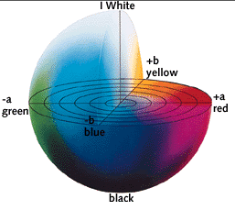
Do the color codes correspond with hue, saturation, and brightness? Or with the three axes of Hering primaries – red-green, blue-yellow, and white-black? The color space is similar in either case given that ‘hue’ is represented by a color circle – so I guess it’s a matter of taste? How you understand the 3 dimensions of color experience?

Slide 37
It’s Over!

